Slide 1

HorAIzon
From Budget to Best Life Insurance Policy — All in One App
By Daniel Lum
19th September 2025

Slide 2

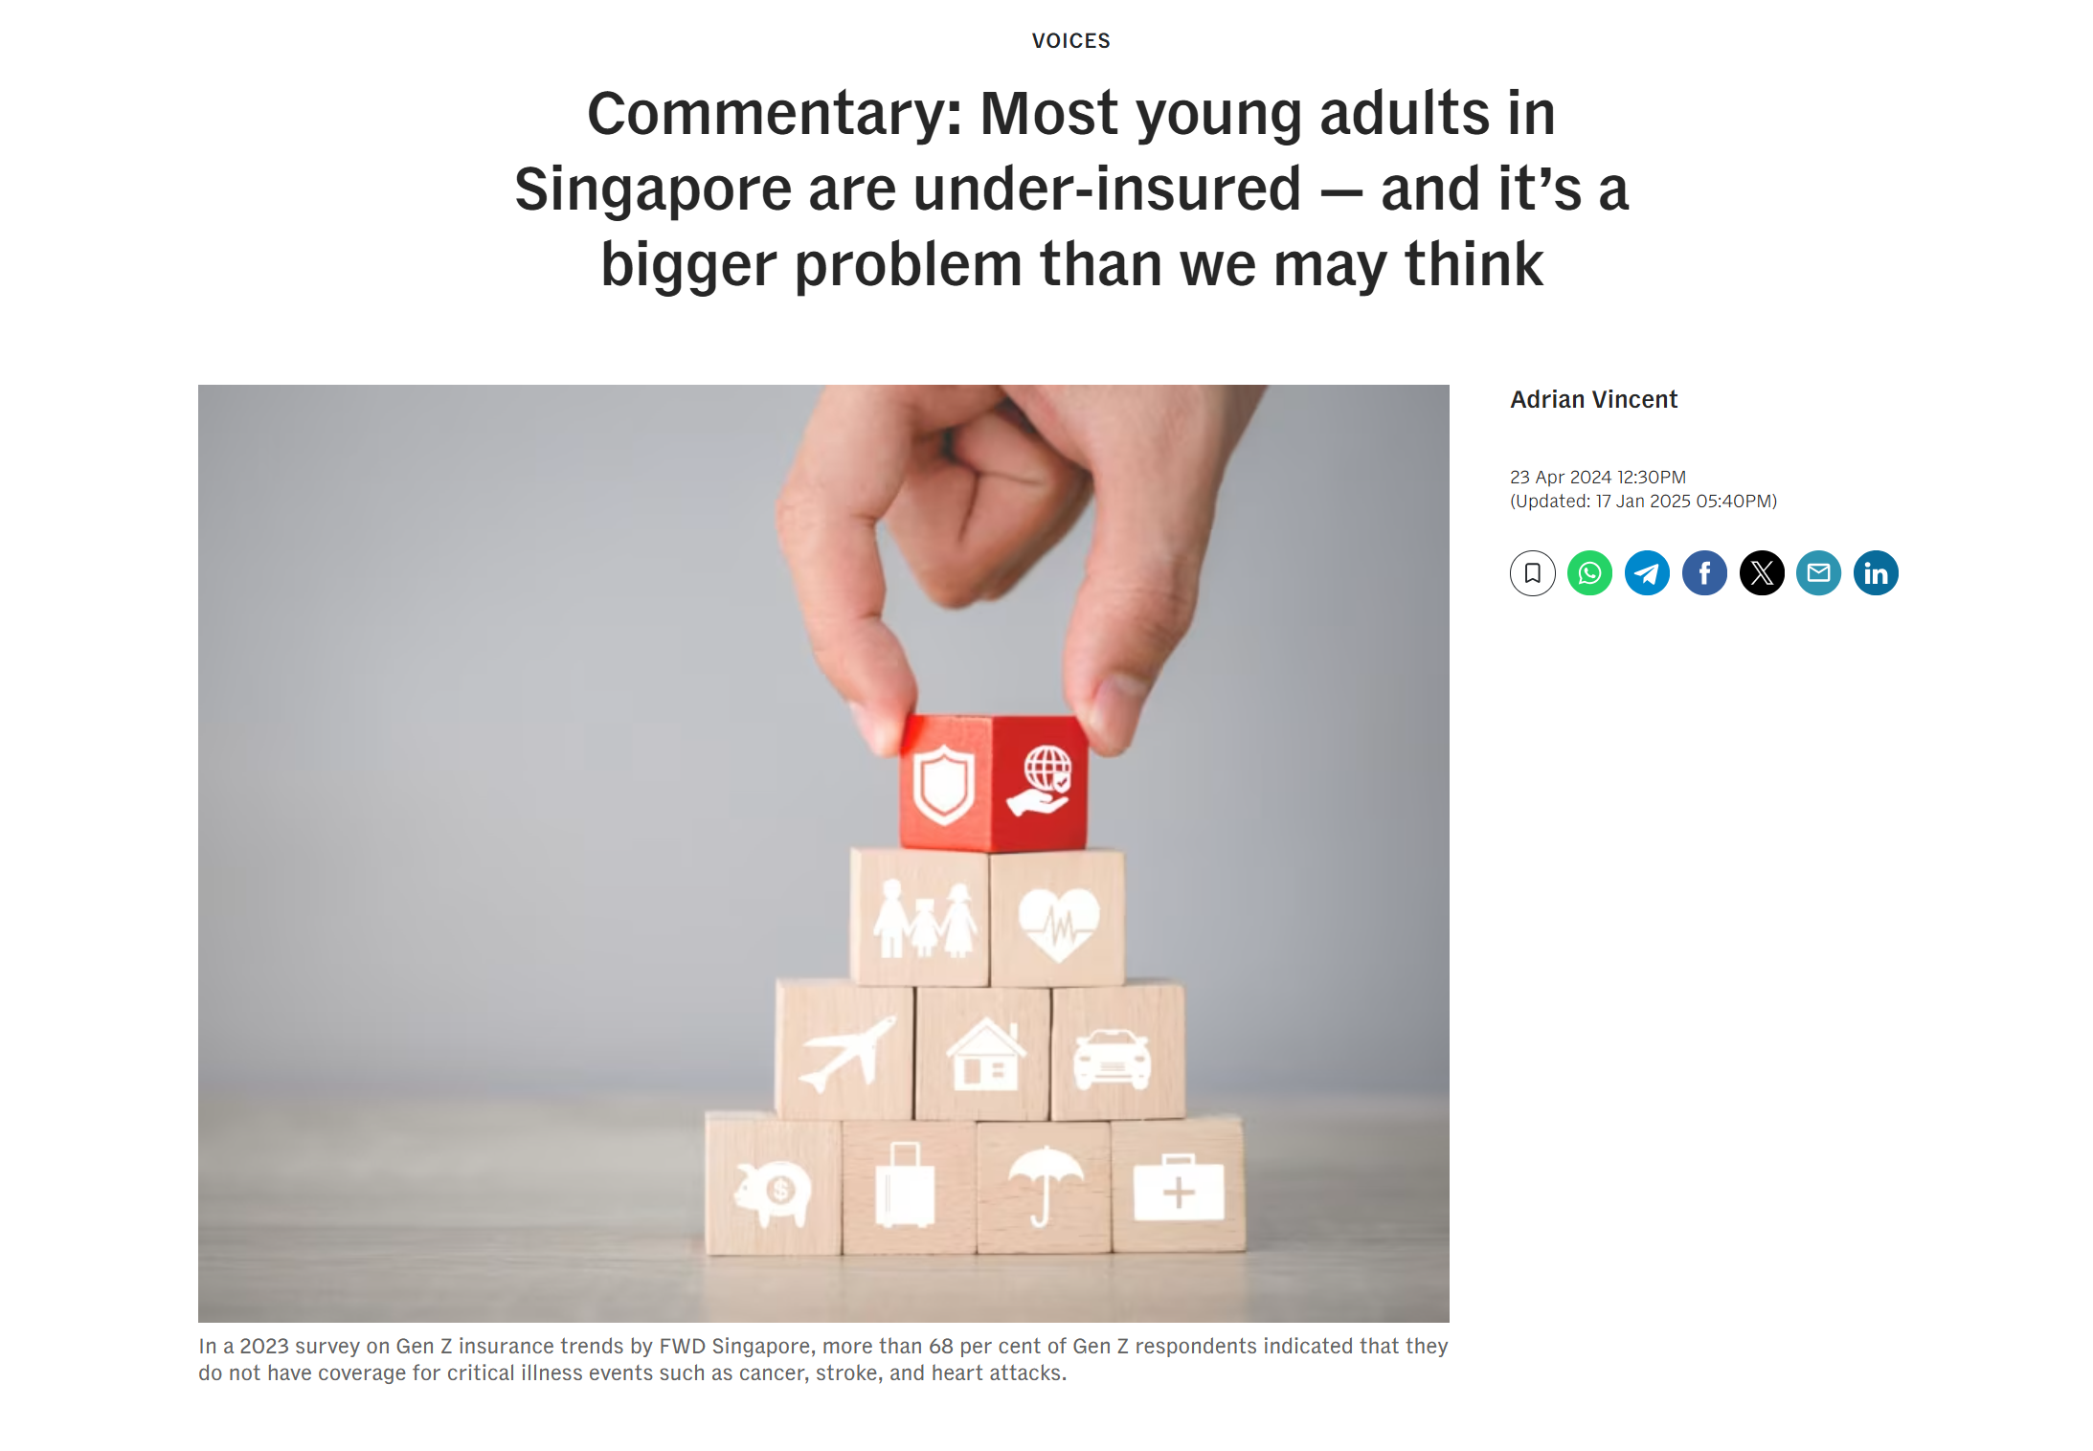
What percentage of Gen Zs are underinsured
CNA: Voices
01

Slide 3

A study on those in their 20s
Lack of Mortality Insurance
Lack of Critical Illness Insurance
68%
83%
02
Data from Life Insurance Association, posted by Asia Advisers Network

Slide 4
The Younger Generation’s Dilemma
“ Financially... an unnecessary expenditure… “
“… understand the importance of being protected… spend on current experiences that they enjoy.”
- Interviews from CNA
03

Slide 5
Where can we go to get a budget?
04

Slide 6
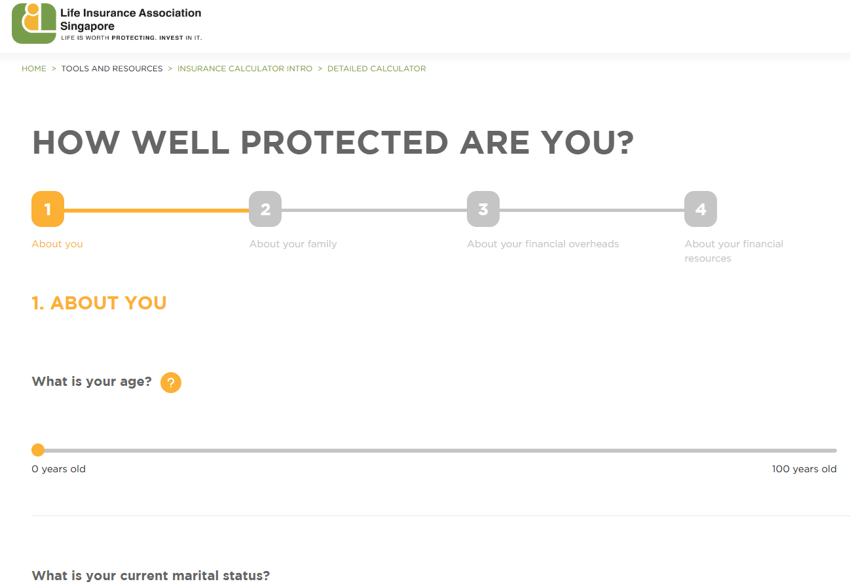
Existing Budget Calculators too lengthy
4 pages of questions to determine budget
05

Slide 7
Where do we go to make comparisons?
06

Slide 8

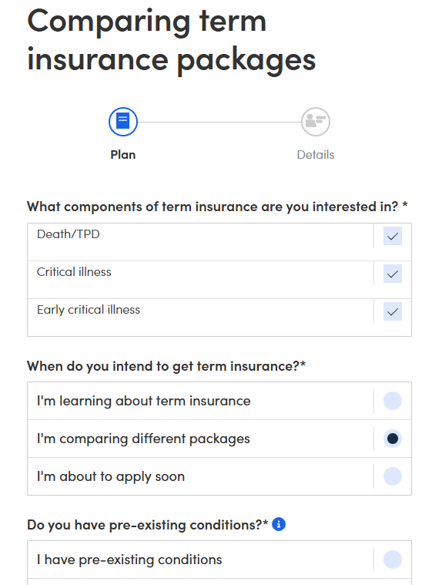
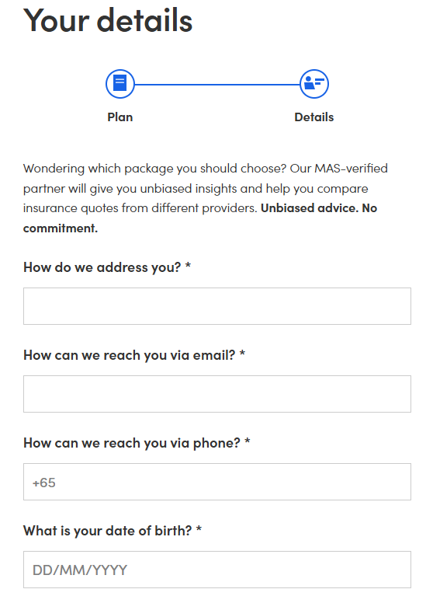
Redirection to Contact Information
07

Slide 9





Consumer Problems
How do I start?
Lack of Public Benchmarks
Insurance not a Priority
On my own how to start?
How much to buy? How much to spend
Insurance tends to take a backseat
No Recommenders
Where to look?
No recommenders online
Information not consolidated
08

Slide 10
How can we create one space to help budget, make comparisons and recommendations for Insurance policies?
09
Our app will be built using Direct Purchase Insurance (DPI) products
Notes:
In the next few slides,
Data we used (2 sets.. Consumers and then insurers)

Slide 11
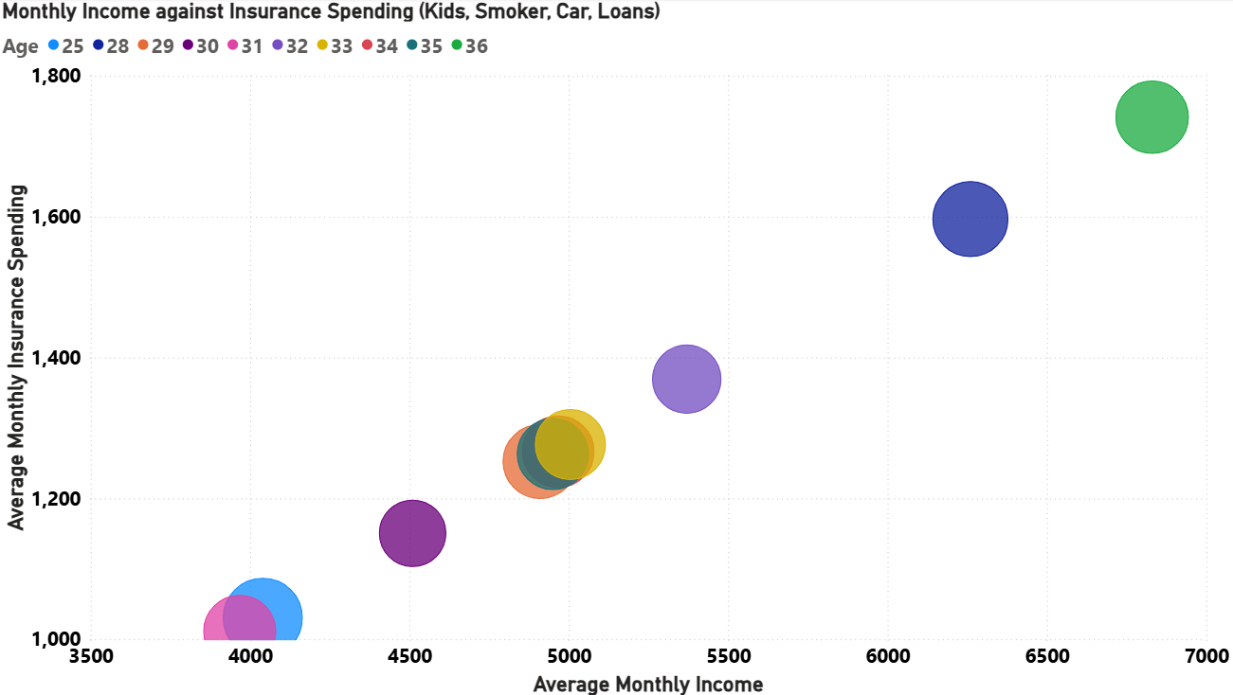
Insurance Spending: More About Lifestyle, Less About Age
Family, Lifestyle & Liabilities affects insurance spending more than age
10
Notes:
Call to action: the more liabilities you take on, the more you need to set aside to spend on insurance

Slide 12
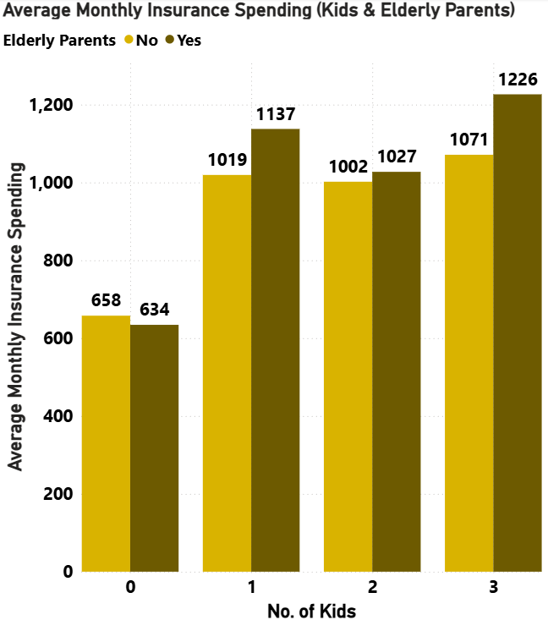

New Parents - Start Budgeting
Largest price spike
Elderly Parents (N): 54.9%
Elderly Parents(Y): 79.3%
11
Notes:
Call to action: couples looking to have kids, you need to start budgeting extra for insurance

Slide 13









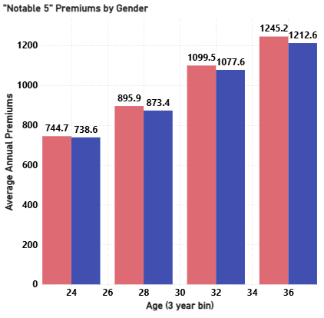
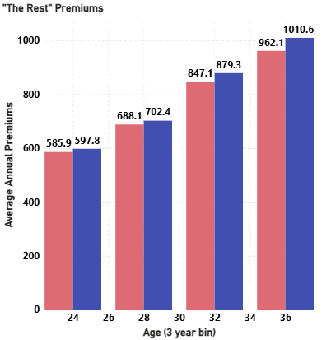
The largest price spike at 30 years old
F: 22.7%
M: 23.4%
F: 23.1%
M: 25.2%
12
Percentages represent the largest increase in price and it happens after 30 years old

Slide 14
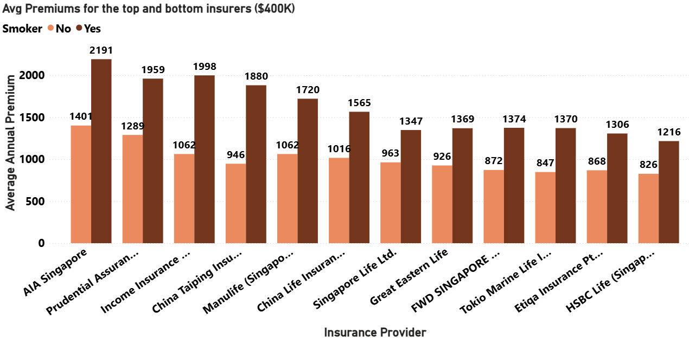

Smokers pay ~55.1% more
Smokers can buy from here
13
Notes:
Call to action: smokers you know where to buy your insurance from
In the next few slides, we will talk about the models
2 models, 1 to predict the budget and 1 to recommend policy.
Both of which built on top of the users inputs

Slide 15
Models used
Bagging
Boosting
RandomForest
ExtraTrees
The majority vote of a collection of models to get the final outcome
XGBoost
Light GBM
Model keeps improving on itself until you get a very accurate model
14

Slide 16
Classifier Model Results
4 Models Ran: XGBoost the Winner
 | TR Accuracy | TE Accuracy | Run Time
RandomForest | >99% | 93.47% | 98ms
ExtraTrees | >99% | 93.68% | 117ms
XGBoost | >99% | >99% | 94ms
LightGBM | >99% | >99% | 155ms
Classifier Models: Used to predict Categorical Outcomes
15
Notes:
Model selection based on results

Slide 17
Regressor Model Results
4 Models Ran: XGBoost the Winner
 | TR RMSE | TR Accuracy | TE RMSE | TE Accuracy | Percent Diff | Run Time
RandomForest | $28.01 | >99% | $54.18 | 93.47% | 2.05% | 37ms
ExtraTrees | < $0.10 | >99% | $53.05 | 93.68% | 2.63% | 34ms
XGBoost | < $0.10 | >99% | $30.44 | >99% | 0.86% | 8ms
LightGBM | $23.27 | >99% | $40.25 | >99% | 0.96% | 8ms
Regressor Models: Used to predict Continuous Outcomes
16
Notes:
Model selection based on results

Slide 18
Modelling - Results
XGBoost Classifier
> 99%
94ms
> 99%
Accuracy
Fastest Run Time
Precision
XGBoost Regressor
> 99%
8ms
44%
Accuracy
Fastest Run Time
Reduction in Error
17
Notes:
kiv

Slide 19

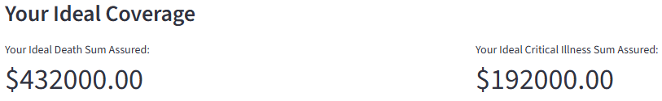
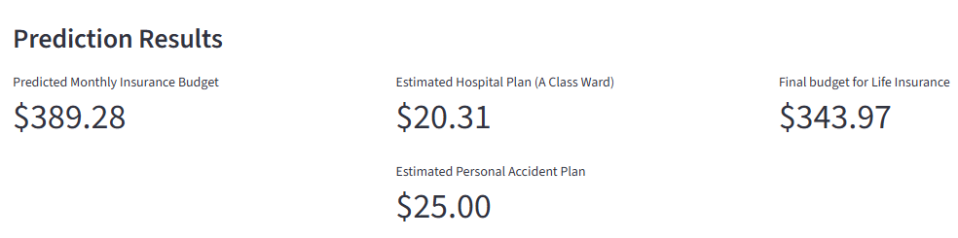
Demo – User Profile
9X AI ¹
4X AI ¹
Alex
Gender: Male
Age: 26 years old
Monthly Income: $4,000
Marital Status: Single
Smoker: No
Own Car: No
Kids: No
Elderly Parents: No
Home Loan: No
Other Loans: Student
Average Expenses: $1,000
Est. Savings: $5,000
These are must haves
18
¹ DBS Article

Slide 20
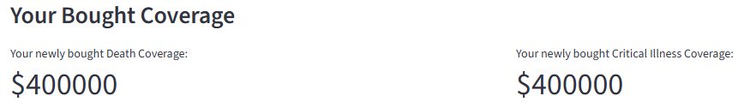
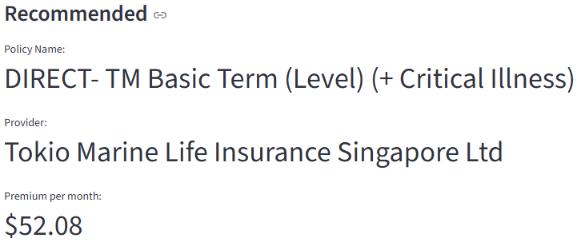
Demo - User Profile
Alex
Preferences: None
Critical Illness Cover: Yes
Existing Insurance: No
15.14%
$343.97 - $52.08 = $291.89
Budget Utilisation
$343.97 - $92.67 = $251.30
26.90%
(If Alex had just gone with AIA)
Budget Utilisation
19
Notes:
Demo follow up

Slide 21


Benefits
Individuals
Insurers
Compare plans
Get a budget
Get recommendations
Convenient
Agents can adjust sales pitch
Calculate client’s budget accurately rather than rely on benchmark figures
20

Slide 22



Scalability
Monetise
Deployment
Data Pipeline
Partner with Insurance Agencies
- data driven recommendations, prevents misselling
(chasing comms)
Users can now do their own research can do everything in one space
Partner with MAS and Life Insurance Association (LIA) to get up to date data to keep this app current
21

Slide 23



Conclusion
Problem
Solution
Impact
If someone wants to buy a DPI, there is no platform for them to identify their budget, compare prices and get a recommendation
Creating an app that brings in accurate budget calculations, price/policy comparisons and makes a recommendation
Our product can help a user budget more accurately, recommend a policy
With it’s convenience we can work to eliminate underinsurance
22

Slide 24

THANK YOU

Slide 25
APPENDIX

Slide 26

Caveats
Control
DPI is extremely controlled by the MAS
Restrictions on how much coverage one can purchase, the range is $50,000 to $400,000.
The total number of DPI policies aggregated, cannot exceed $400,000 sum assured
Notes:
MAS control: Although the sum assured limits are controlled, the purpose of DPI is to provide a good starting point for fresh graduates or people entering a new phase in their lives. It helps cover the shortfall sum assured.

Slide 27
Buy Term Invest the Rest
Comparison
 | Whole Life Plan | Term Plan
Monthly premium | $464 | $75
Payment Term | 35 years | 30 years
Coverage Term | 65 years | 30 years
Total Premiums Paid | $194,810 | $27,060
Guaranteed returns¹ | $104,400 | -
Non-Guaranteed returns² | $219,643 | -
Total returns – Total premiums | $129,223
¹30 year projected returns
²Based on projected yield of 4.25%

Slide 28
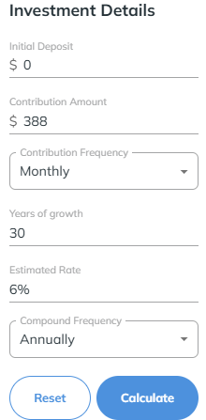
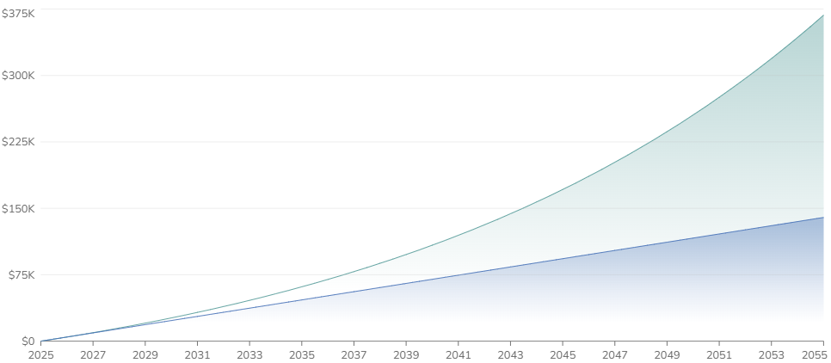
Return on Investment
Balance: $368,095
Profit: $228,415
Principal: $139,680
Stashaway: Compound interest calculator

Slide 29
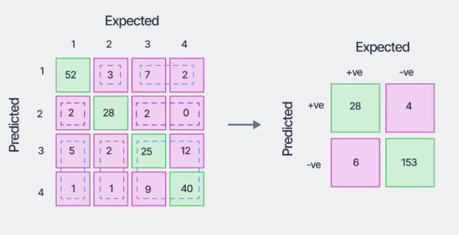
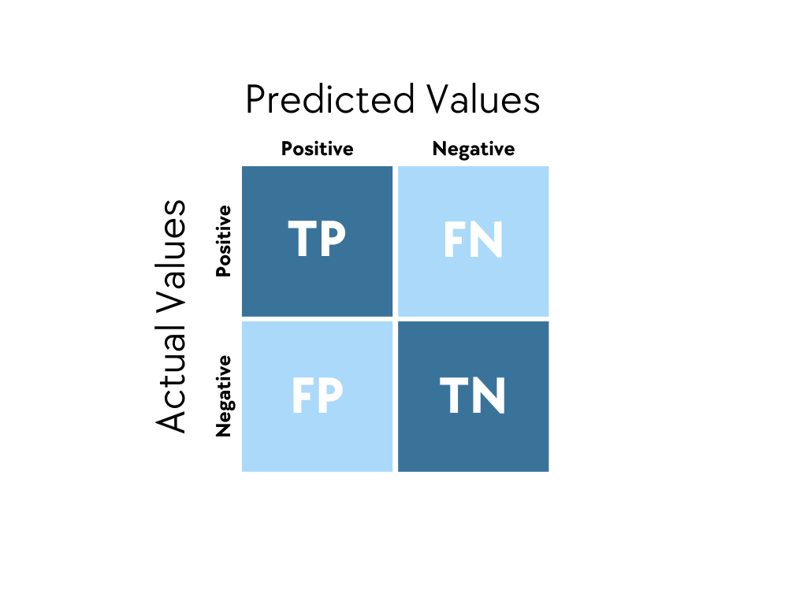
Explanation on Confusion Matrix
True Positive (TP): The model correctly predicted a positive outcome
True Negative (TN): The model correctly predicted a negative outcome
False Positive (FP): The model incorrectly predicted a positive outcome when it was actually negative (Type 1 Error)
False Negative (FN): The model incorrectly predicted a negative outcome when it was actually positive (Type 2 Error)

Slide 30
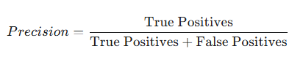
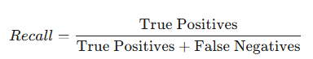
Explanation on Confusion Matrix
Recall (Thoroughness):
This is about the real world. Of all the policies that were actually DIRECT - Great Term policies, how many of them did the model successfully find? A high recall means the model is very good at finding all the examples of that policy type and doesn't miss many.
Precision (Trustworthiness):
This is all about the model's claims. When the model says, "This is a DIRECT - Great Term policy!", how often is it right? A high precision means you can trust the model when it makes that claim. It doesn't make many false alarms.

Slide 31
Existing Industry Solution
Direct Purchase Insurance
(DPI)
Launched in 2016
Buy Online
No need for a Financial Consultant
Simple and Straightforward
Comprehensive starting point
Low cost
Full control
40.7% of Insurance Market
05

